Slide 1





































































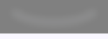








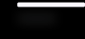


















Mentorship Feature on LinkedIn
Virendra Kumar Verma
E-Cell Project

Slide 2



























PROBLEM
Observing users posting requests seeking mentors to help them accelerate their careers. Also, there are users putting their availability for one-to-one limited interaction for sharing their knowledge and mentoring others in the space they have experience in.
I have decided to propose a mentorship feature, where-in users can connect with mentors and seek knowledge and mentorship.
LOGIN
NEW ACCOUNT

Slide 3



About LinkedIn
LinkedIn is a social network that focuses on professional networking and career development.
Unlike other social networks such as Facebook and Myspace, which are often purely recreational, LinkedIn emphasizes a user’s professional connections.
LinkedIn allows users to further their careers by searching for jobs, ﬁnding connections (even at third hand) at a particular company, and receiving recommendations from other users.
Competitors

Slide 4


User Persona
Demographic
24
Age:
Employment Status: Location:
Working in MNC India
Frustrations
Feels very tough to look for a correct mentor who matches my requirement
Interests
Interested to learn and explore new skills to transition to new job

Slide 5

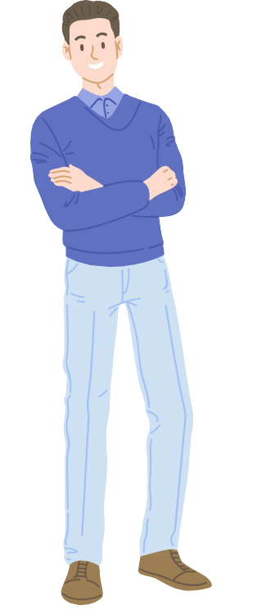



User Persona
75% Creativity
60% Precision
Demographic
45
Age:
Employment Status: Location:
Manager in MNC India
80% Ingenuity
Goals
Passionate about work and want to share knowledge with like-minded people
Frustration
Cannot ﬁnd platform where, I can showcase my talent and mentor young folks

Slide 6









Approach
I am planning to have two screens in which one will be for mentee and other will be for mentor
Mentor Screen
Mentee Screen
Mentor Screen will have features such as they can choose mentees with whom they align and want to mentor.
Mentor will get an option to accept request from mentee
Mentee screen will have details of mentors and areas in which they want to expand their skill set.
Mentee will be able to send request to mentor.

Slide 7
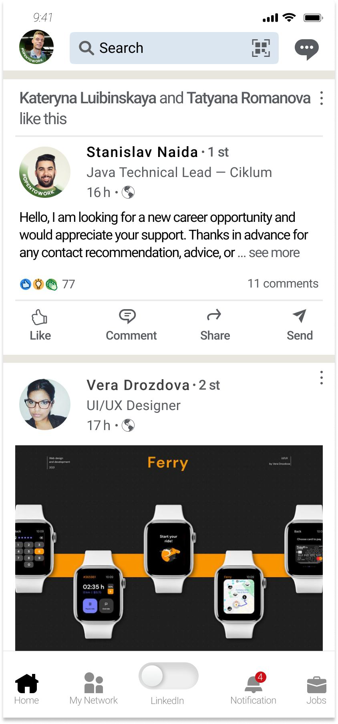
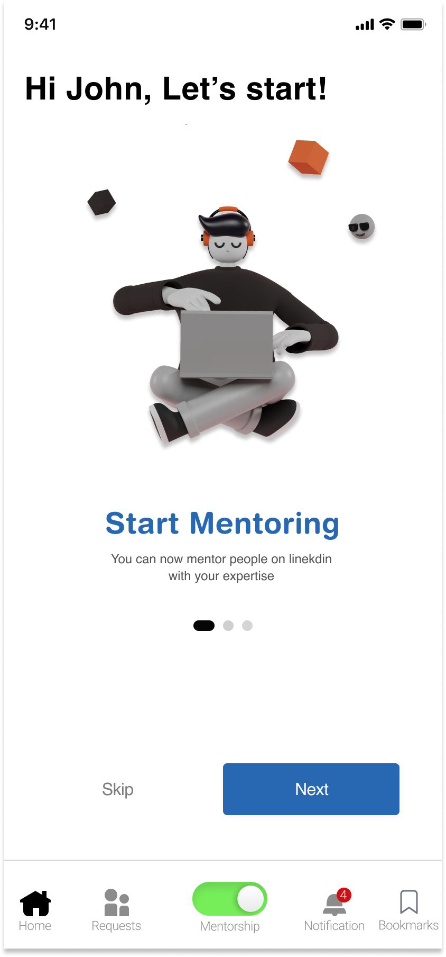
Wireframing
As soon as users switched to mentorship feature, they will be onboarded with short intro to how to use the feature.
As linkedin screen already has lot of options, i don't want my users to get confused, Hence I am adding toggle button for mentorship feature.

Slide 8
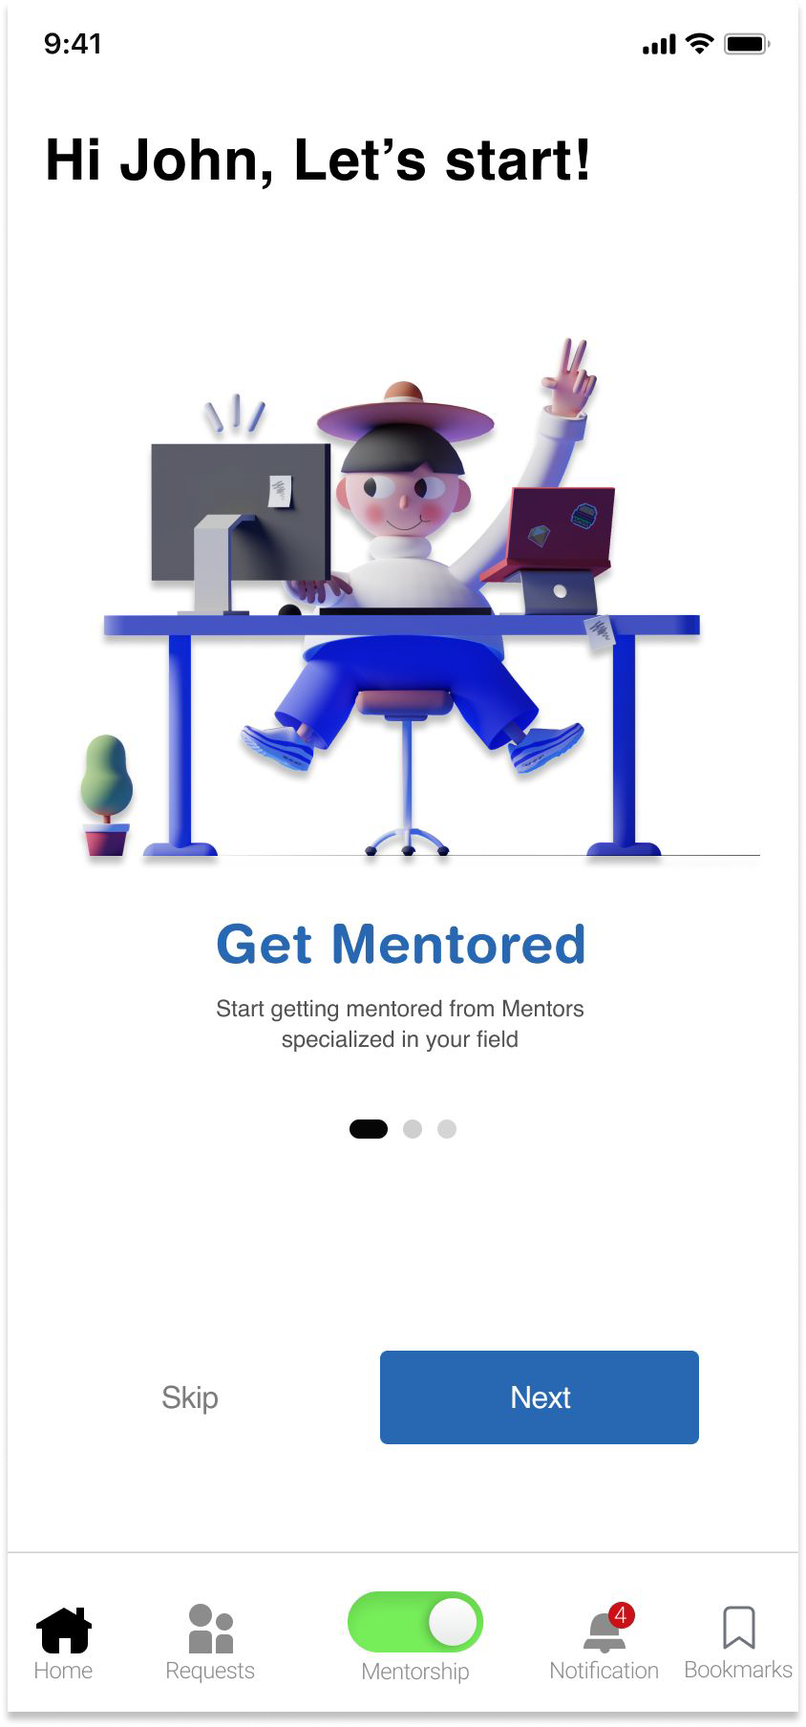
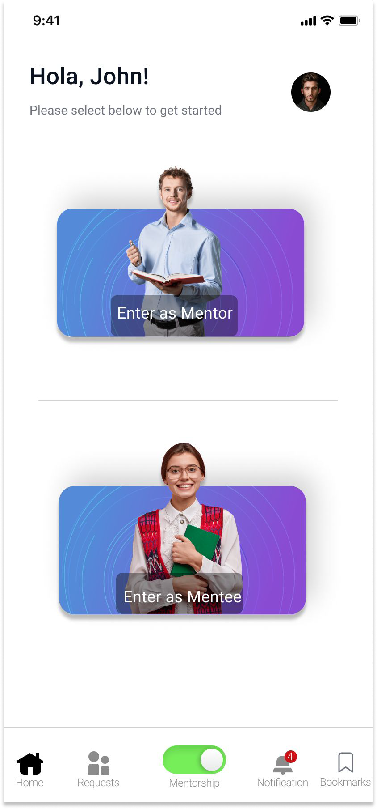
Wireframing
We will show both the feature i.e Mentor and Mentee on onboarding screen
I am allowing user to enter as Mentor or Mentee
Clicks Next

Slide 9
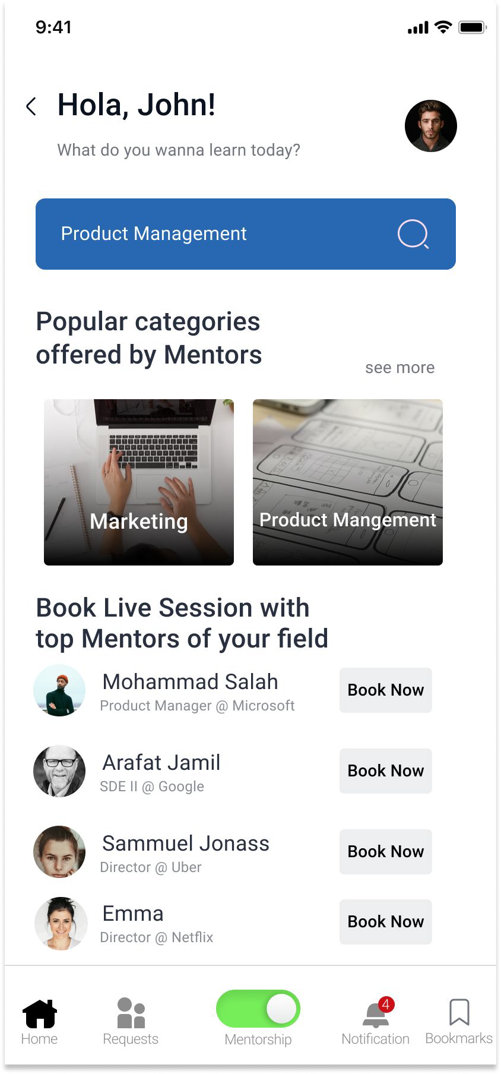
Wireframing - Mentee Screen
Once the user clicks on Mentee. I am offering two feature for mentees -
Mentee screen will have different features such as Search bar to search particular course, look for mentors.
They can directly search for the particular course and can enroll in it to upskill themselves.
Also, if they want to have a session with the mentors, they can book as per their requirement.

Slide 10
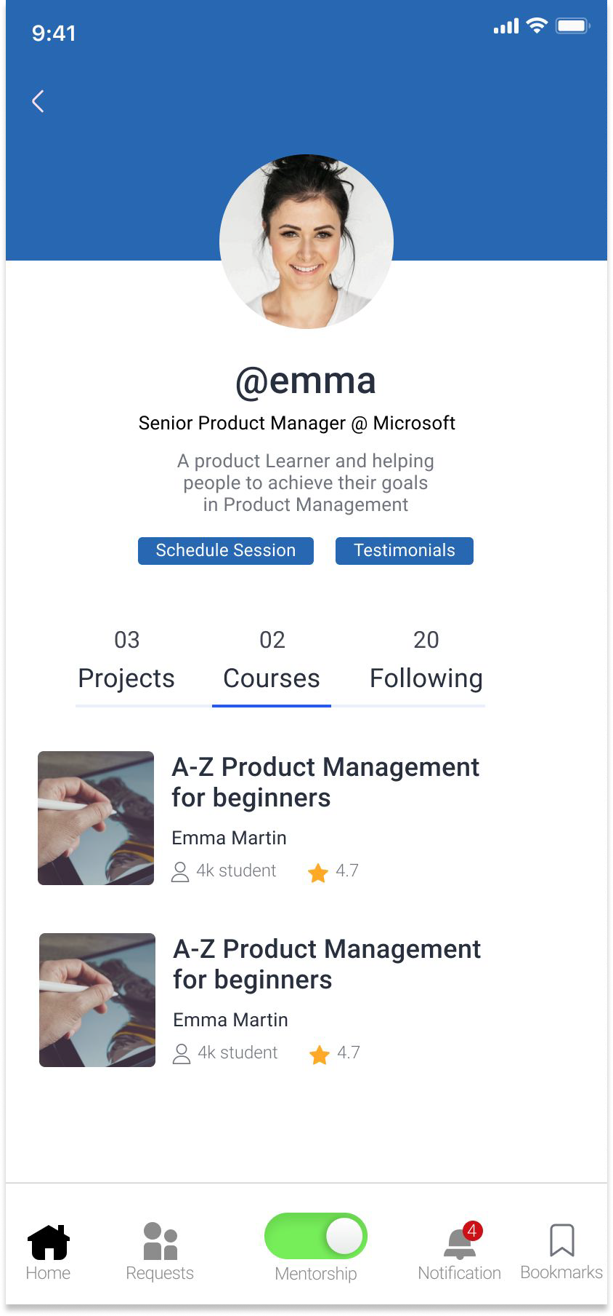
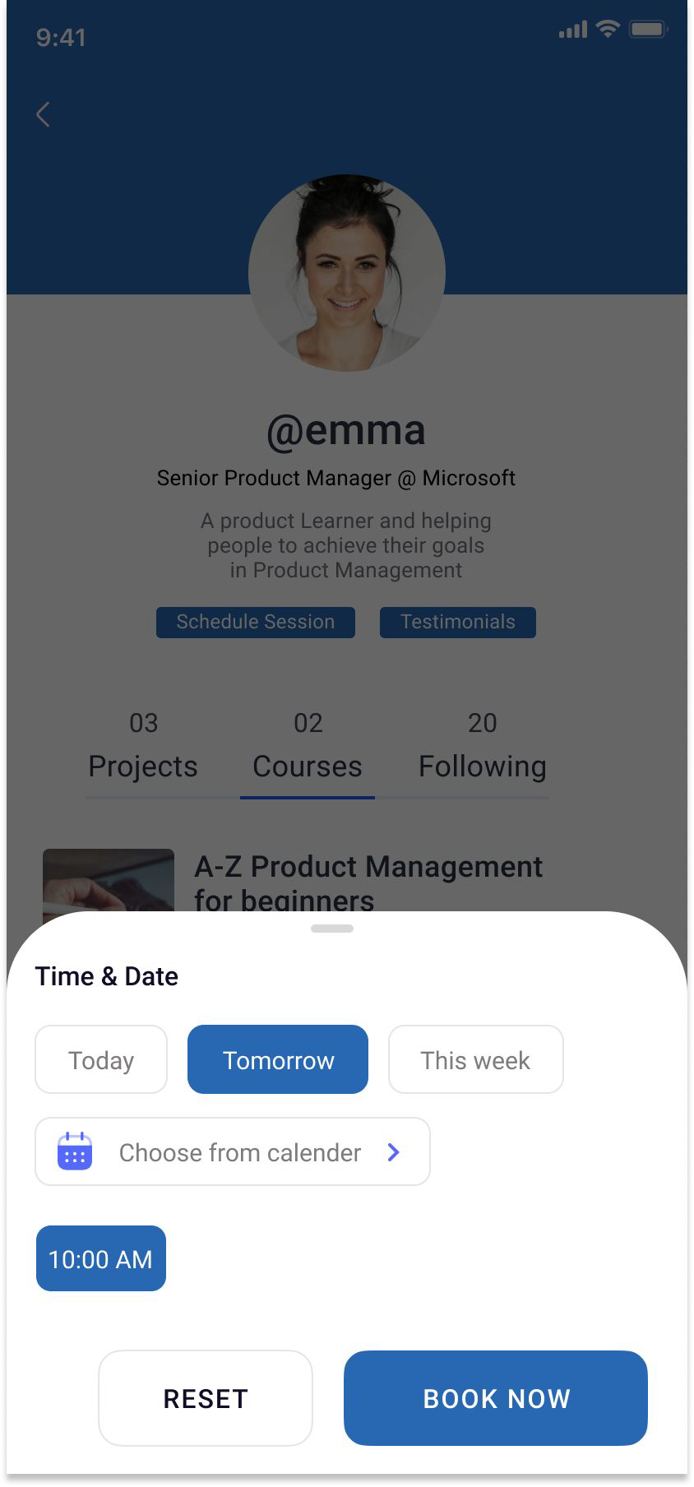
Wireframing - Mentee Screen
As soon as Mentee clicks on book now button on previous screen, the proﬁle of mentor will pop up having two buttons -
Schedule Session
Testimonial
If Mentee clicks on Schedule Session, a slide bar will open up from bottom to book the session.

Slide 11
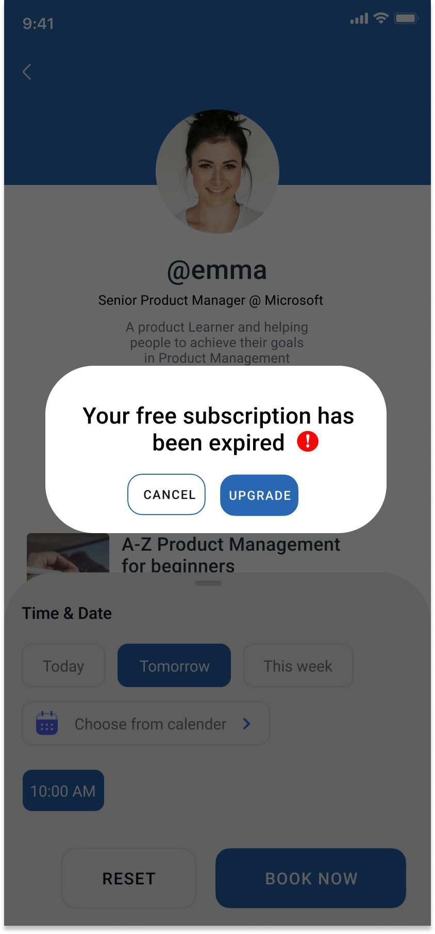
Wireframing - Mentee Screen
Now to have a session with mentors, we will go with Acquisition Approach. In initial days, we will offer session for free but after that we will ask users to upgrade the session and post which they can book as many session as they can.
For pricing, we will offer two ways
If they only want to buy Mentorship feature, then we will charge certain amount.
We can club Mentorship + LinkedIn premium feature together and offer at slightly increased price which will help LinkedIn to upsell membership feature as well.

Slide 12
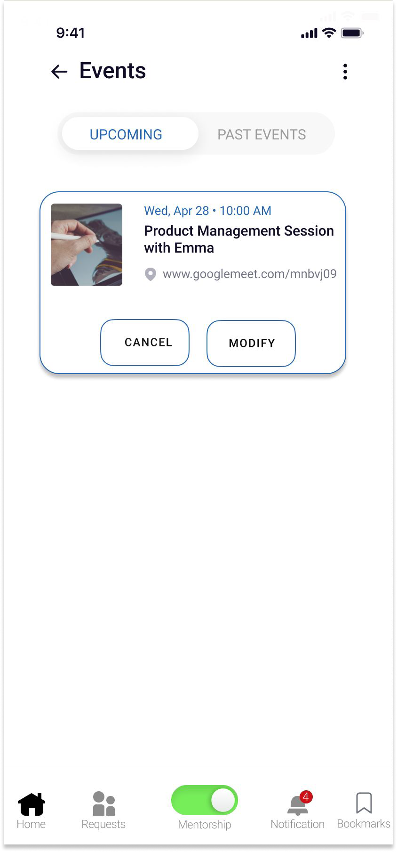
Wireframing - Mentee Screen
Post conﬁrmation of session, Mentees will be able to see their upcoming session under Events section of the screen. We are offering two feature under this -
Cancel button to cancel the session
Modify button to modify timings or reschedule the session

Slide 13
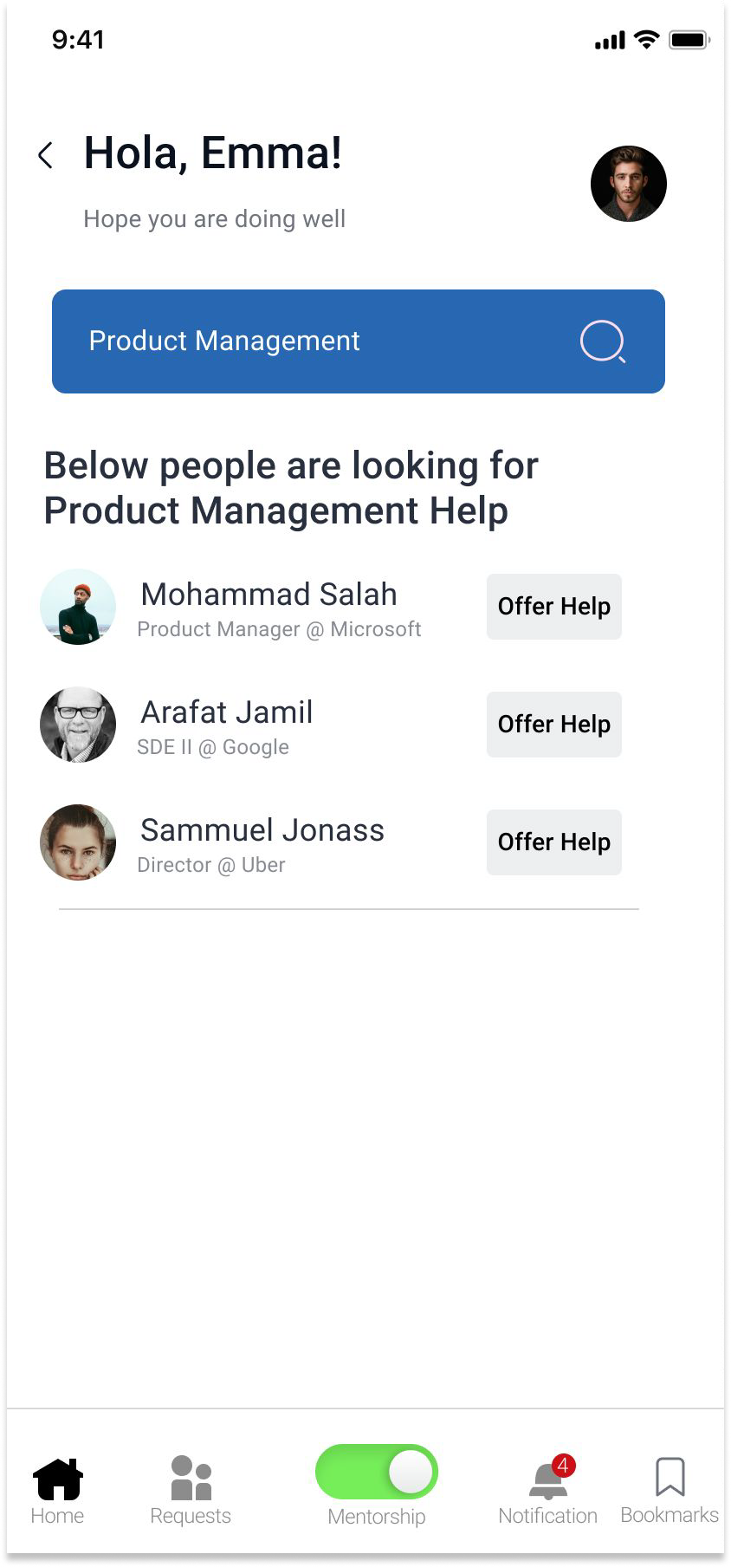
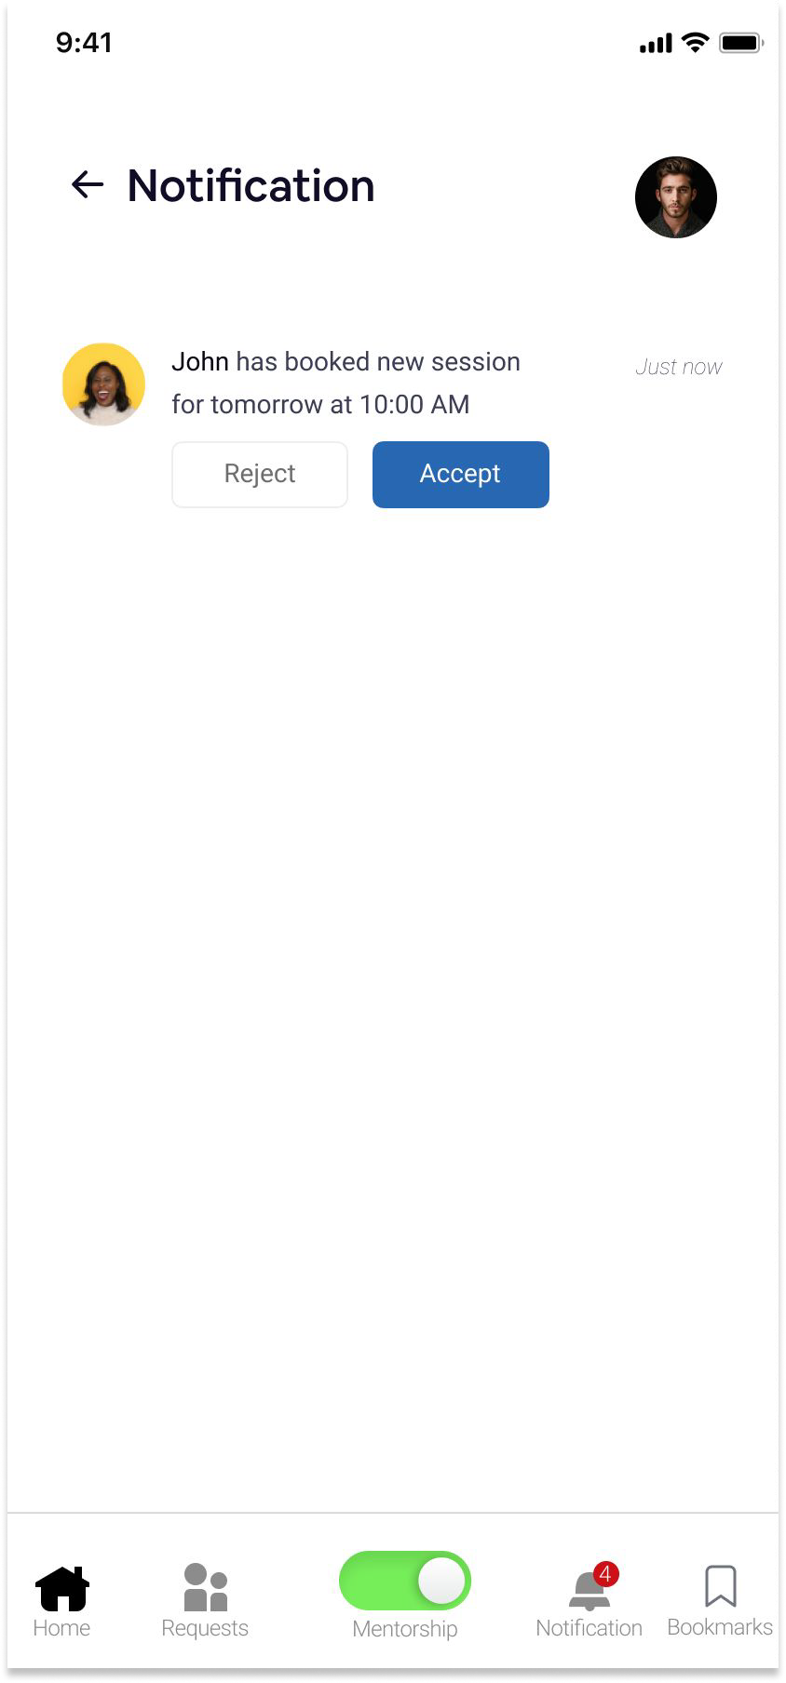
Wireframing - Mentor Screen
This is the mentor screen where they can search with their expertise and look for people who are asking for help and can click on offer help button and further ﬂow will continue.
Now as we saw in previous screen, as soon as session is booked, Mentor will receive the notiﬁcation where they can accept or reject the invite as per their availability.

Slide 14
Feature Success Metrics
 | Goal | Identiﬁer | Metric
Adoption | User start using Mentorship Feature | Increase in screen time under Mentorship Screen | [# of user using feature/Total Number of User] * 100
Retention | User comes back to use the feature | Number of users re-upgrading subscription | [# of Users purchased (current month)/Same users purchased (last month)] * 100
Acquisition | User should upgrade after free trial | Number of users upgrading once free trial ends | [# of users upgrading (current mont)/# of same user whose free trial ended] * 100

Slide 15
Go to Market - Product Led Growth (PLG) Strategy
There can be two types of GTM : Product-led and sales-led are the 2 main types of GTM strategy.
A product-led GTM strategy uses the product itself to acquire and retain users. In this approach, the product serves as a salesperson by providing so much value, the user can't help but upgrade their package. Calendly and Slack are great examples of product-led growth in action.
Target Audience
01 03
Distribution
Product Market Fit
02
Competition & Demand
04
Components of GTM Strategy

Slide 16
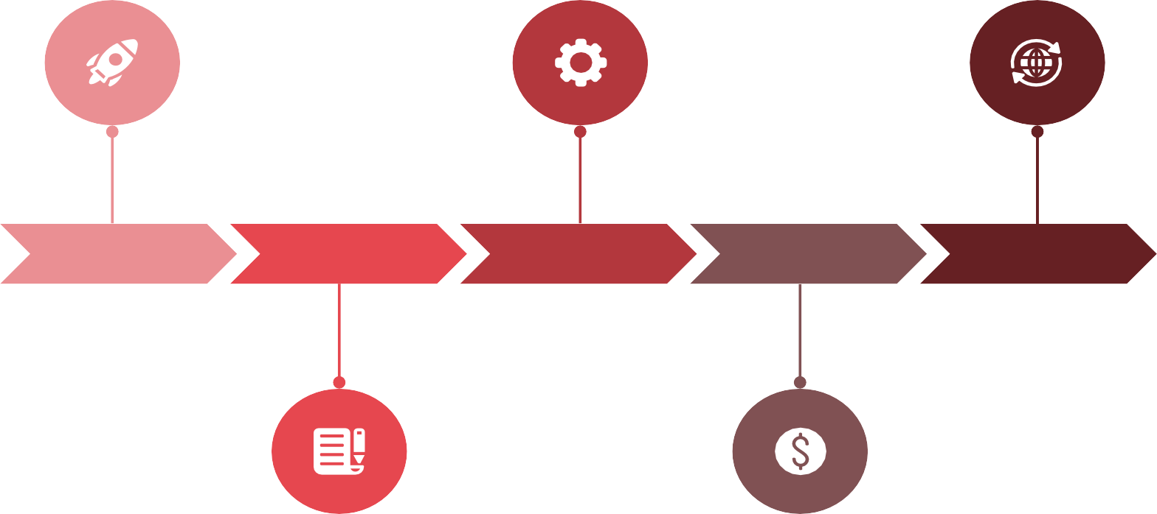
Go to Market - Product Led Growth (PLG) Strategy
Measure Success Metrics to align with the goal
Launch beta version to test the feature
Phase 1
Design and Build the feature
Phase 5
Feature Improvement once full cycle is done
Phase 2
Phase 3
Phase 4
Interview users to get the feedback

Slide 17
Thank You

